Slide 1




INTRODUCTION TO DATA SCIENCE
Data Inflation Rate of Countries
Yap Ming Yee (0126471)
Teoh Zhen Ee (0128372)

Slide 2




Introduction
The research we have conducted is about the Inflation Rate of countries from the year 1960 to the year 2021. This is a study analysis to understand the inflation rate of the countries and to find out any correlation between the countries that suffer from high Inflation. This analysis focuses on colonized and non-colonized countries because Inflation rate depends on a lot of different values that vary from country to country. Volatile global energy costs, varying currency values by nation, unpredictable growth of aggregate demand, erratic food prices, shifting government tax policies, and others are a few of the associated factors.

Slide 3


Research Question :
Does the history of colonization influence the inflation rate of colonized countries?
Hypothesis :
Countries colonized have a higher inflation rate than countries without historical colonization.
Alternative Hypothesis :
Colonization of countries does not have an impact on the inflation rate of the country.

Slide 4

Methodology
Method of collecting data :
The dataset being used in this study is the Inflation Rate of Countries from year 1960 to 2021, the dataset was collected from countries by the World Bank. Since the data is collected by the world bank, it consists of data to some degree with a political view point, which in this case translates to missing and null values from some countries. The world bank did not provide some details from some countries or the countries did not provide this information to the world bank due the various reasons.

Slide 5
Methodology
Data visualization method :
The graphic display of information and data is known as data visualization. Data visualization tools offer an easy approach to observe and analyze trends, outliers, and patterns in data by utilizing visual elements like charts, graphs, and maps. Using graphs to present the data over the progress of Inflation Rate to compare them with colonized and non-colonized countries to find out the correlation and the determine if there are some factors that determine the progress of Inflation Rate. By using line graphs, it provides an accurate representation of the trend of Inflation in the country then comparing the countries together to find out if the colonized countries have on average a higher Inflation, then non-colonized countries. We will also find out if the influence of the non-colonized country is still in effect in modern days, as well as comparing some countries that have a lower Inflation Rate then the countries that colonized them in the past.

Slide 6
Methodology
Random Forest Algorithm :
Using Random Forest classifier to find out if the Inflation Rate of a country next year will increase or decrease. Random forest and other supervised machine learning algorithms are frequently used in classification and regression problems. It builds decision trees from different samples, using their average for categorization and majority vote. Random Forest classifier decorrelates the trees with the addition of splitting on a random subset of characteristics, random forest outperforms bagging.This indicates that the model only takes into account a small subset of features rather than all of the model's features at each split in the tree. While the trees are developing, the random forest adds more randomness to the model. When dividing a node, it looks for the best feature from a random subset of features rather than the most crucial one. Because of the wide diversity created by this, the model is generally better. So, in this model we will be inputting the values of 0 and 1 in an array with 64 values since we are going to be using 64 countries, the 0 values represent No which the 1 value represents yes.

Slide 7
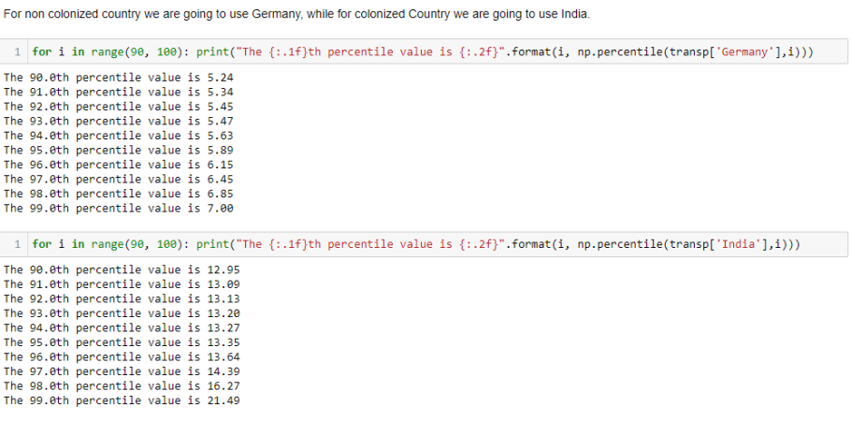
Results
Calculating percentiles of countries that were colonized and non-colonized

Slide 8
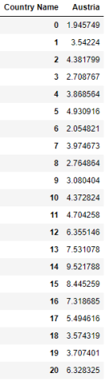
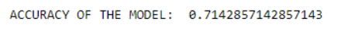
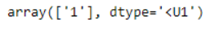
Random Forest Classification to check if the Inflation Rate next year will be higher or lower
71 %
By using X as the country, we want to classify and Y as the Yes and No factor. We are able to use Random Forest Classifier to predict the result. Although the accuracy of the model is at 71%. It provides a look into the result. The training set of the model will consist of 90% of the data within the dataset while the testing model will consist of 10% from the training set.
The results showcase the value of 1 which is no, the model suggests that Austria will not have a higher Inflation Rate in the year 2022 since its Inflation Rate was already at 3% in 2021, the model has a 71% confidence that 2022 Austria will not have a higher Inflation Rate.

Slide 9
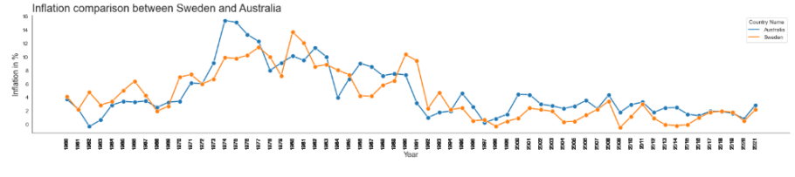
Discussion
This graph is a representation of colonized and non-colonized country. Australia is a country which was colonized by the United Kingdom while Sweden is a country that has never been colonized. We can see the Inflation rate for both countries are relatively similar over the years. When Inflation rate raises, it happens to both countries. This is one of the examples of not all colonized countries will have higher Inflation then non-colonized countries.

Slide 10
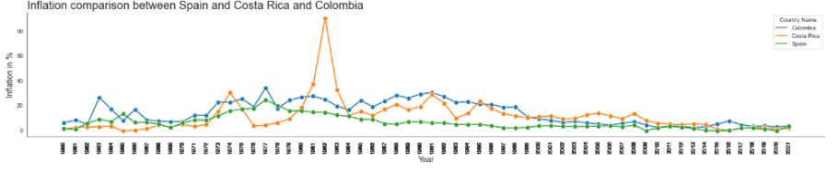
Discussion
Next, we will be talking about the influence of countries that colonized other countries.
We can see the inflation rate of Spain, the country that colonized both Colombia and Costa Rica, has never achieve a 20% Inflation rate over the period of 61 years. Although Colombia doesn’t have hyperinflation, their inflation rate is still higher than Spain, on the other hand, Costa Rica has had hyperinflation at some point of the countries’ independence. This does not provide enough evidence that Spain the country which colonized Costa Rica is the main caused of its Inflation rate. We will use another example.

Slide 11
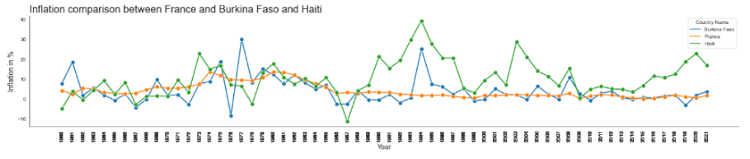
Discussion
France is the country that colonized both Haiti and Burkina Faso. Both colonized countries have had unstable economy over the years since their independence from France. Haiti and Burkina Faso both have periods of hyperinflation and has never had a period of economy stability like France. France’s economy has never differ away more then 5% over the period of 61 years.

Slide 12
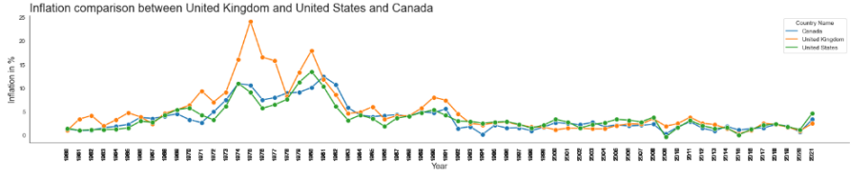
Discussion
On the other hand, United States and Canada both have a stable economy and lower Inflation rate then the United Kingdom which had colonized both countries. This is an example of not all colonized countries are influence by colonizing countries.

Slide 13
Conclusion
The purpose of this study was to find out if the history of colonization influences the inflation rate of colonized countries. The hypothesis propose was the countries colonized have a higher inflation rate than countries without historical colonization. Colonized Countries have on average higher Inflation Rates compared to their non-colonized counterparts. The Inflation rate of colonized countries tend to have a period of dramatic hyperinflation then the inflation rate will decrease over a few years. Compared to colonized countries where their inflation normally will increase within 2 or 3% over some years then return to normal. Colonizing countries does have some impact on their Inflation Rate for the majority but it does not remain the same for countries like Australia and United States. Some colonized countries can have a lower Inflation Rate than the non-colonized countries. Variously factors contribute to Inflation, although colonizing has some Impact to countries that have a weak economy but it is not the deciding factor of Inflation for colonized countries. Countries that have a high Inflation rate are often affected by war, high price fluctuation of local products, sudden price increase of imported goods.

Slide 14

Thank You!
Do you have any questions for me before we go?

